Slide 1
What’s in a smartphone?
Gary.Hoggard@mountcarmel.tas.edu.au March, 2019

Slide 2
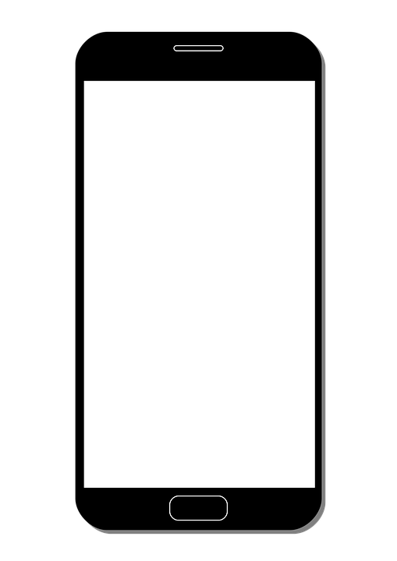
Smartphone
Computer

Slide 3


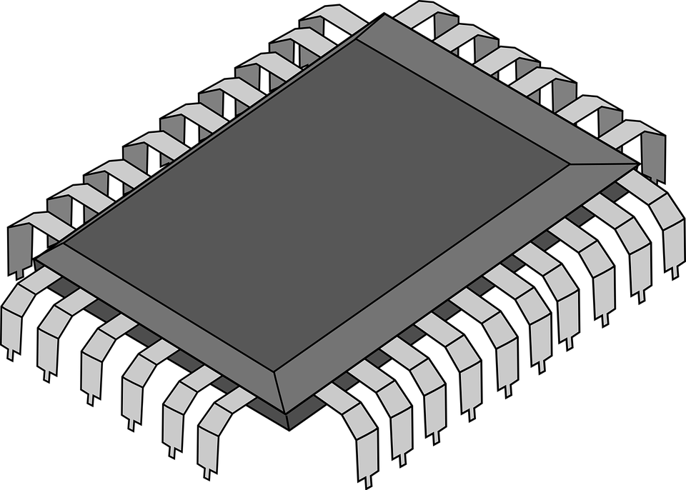
Speaker
Touch-sensitive screen
Microphone

Slide 4
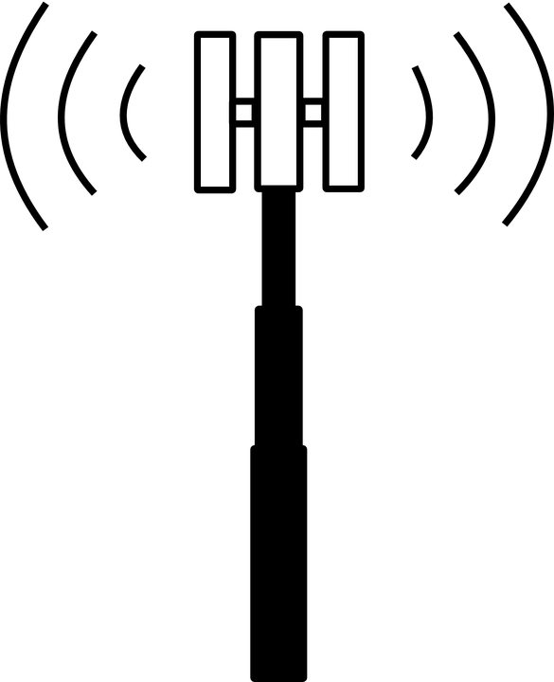



Telephone
application
Telephone cell tower
Notes:
Telephone

Slide 5
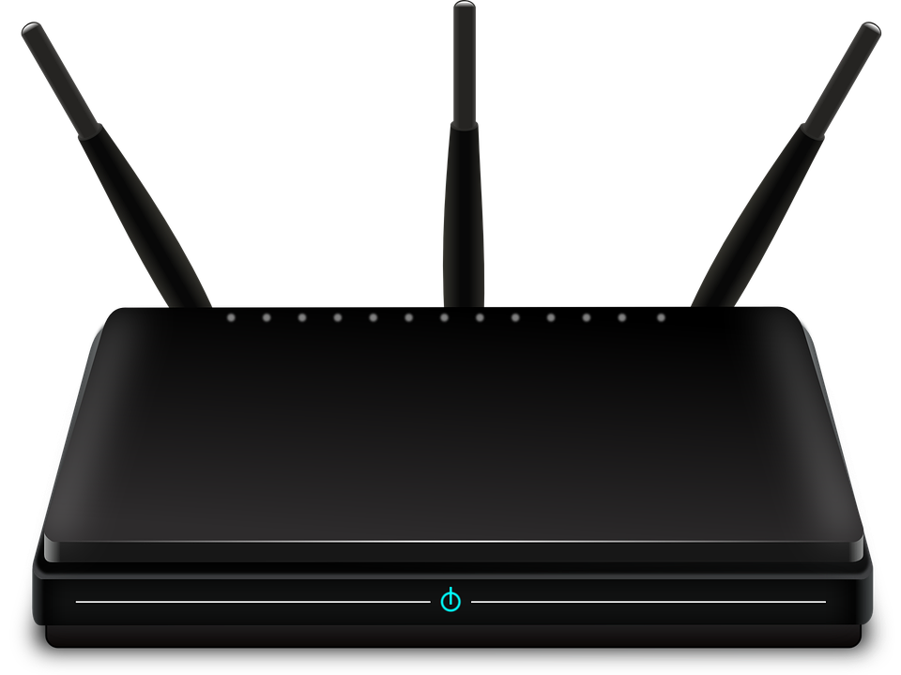







WiFi
applications
Internet
Notes:
WiFi client, e.g. web browsing, apps, etc.

Slide 6

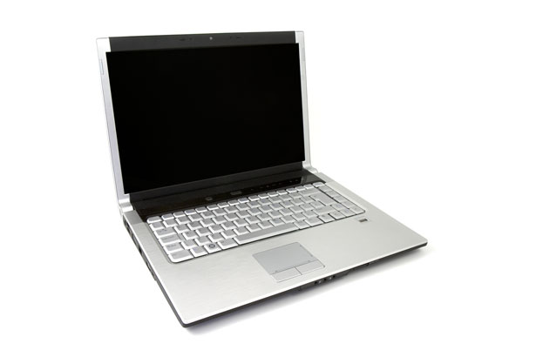

WiFi
Access Point
(“hot-spot”)
Notes:
WiFi access point, “Hot spot”

Slide 7



FM Radio
Notes:
FM radio receiver

Slide 8
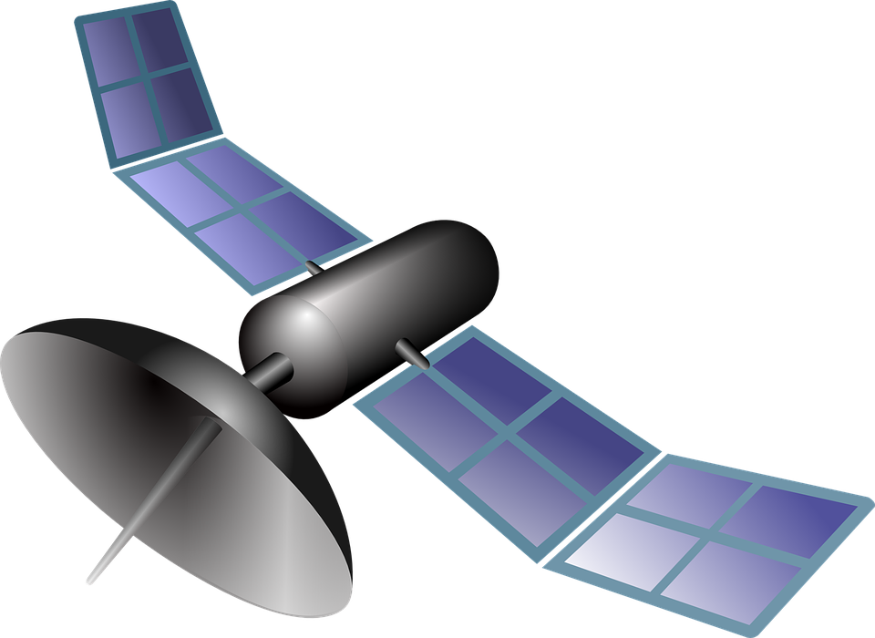


GPS
Receiver
GPS = Global
Positioning
System
Notes:
GPS receiver. Google Maps & other GPS apps

Slide 9

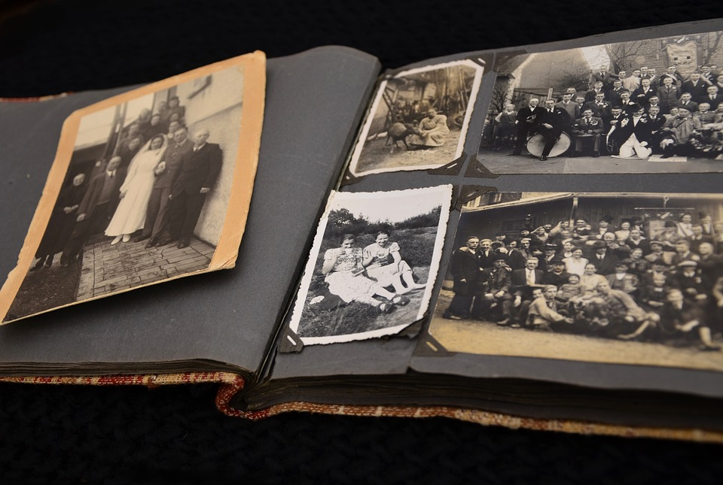






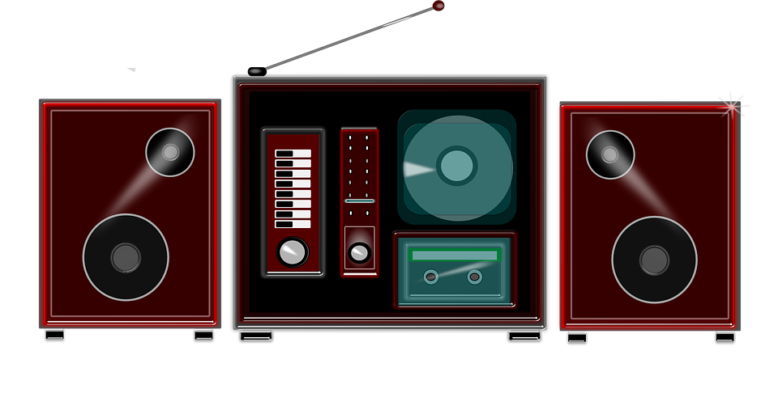
Local
(or stand-alone)
Applications
Notes:
Local apps: camera, photo viewer, music

Slide 10




Bluetooth
transceiver
Notes:
Bluetooth transceiver. External speakers, headphones, keyboard, etc.
NFC (near field communication).

Slide 11
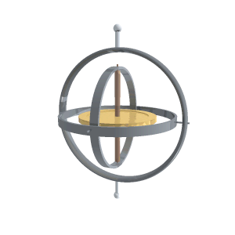
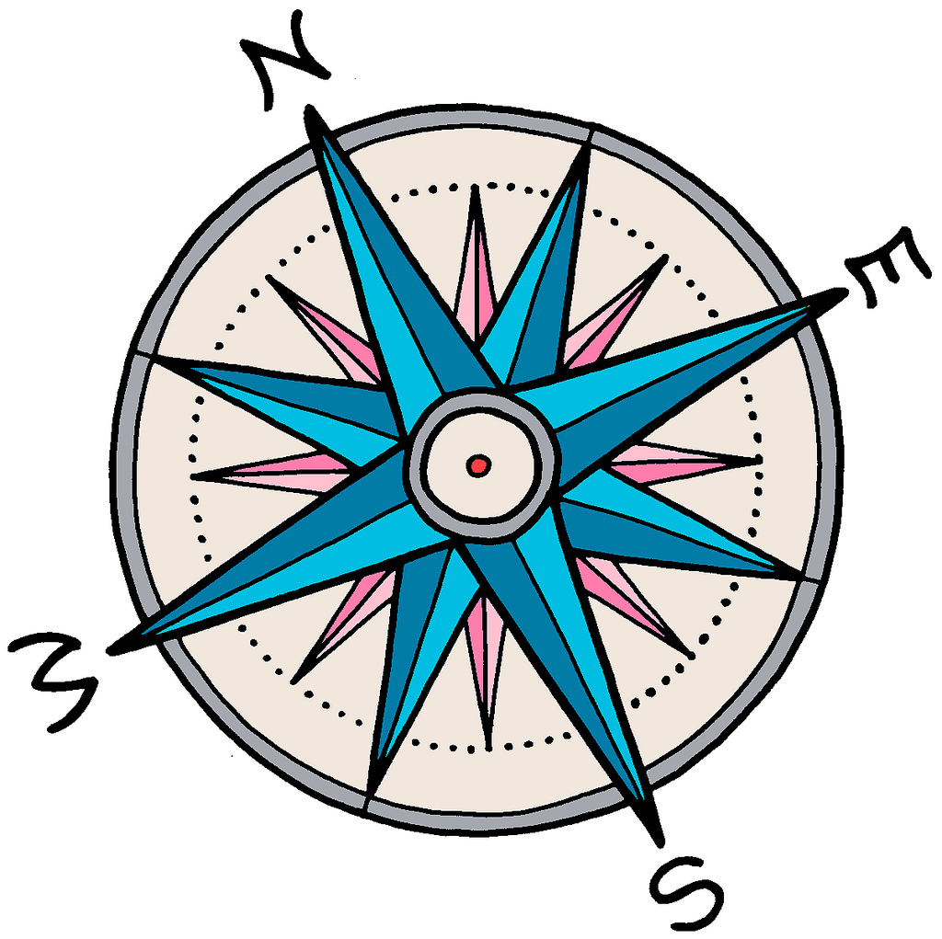

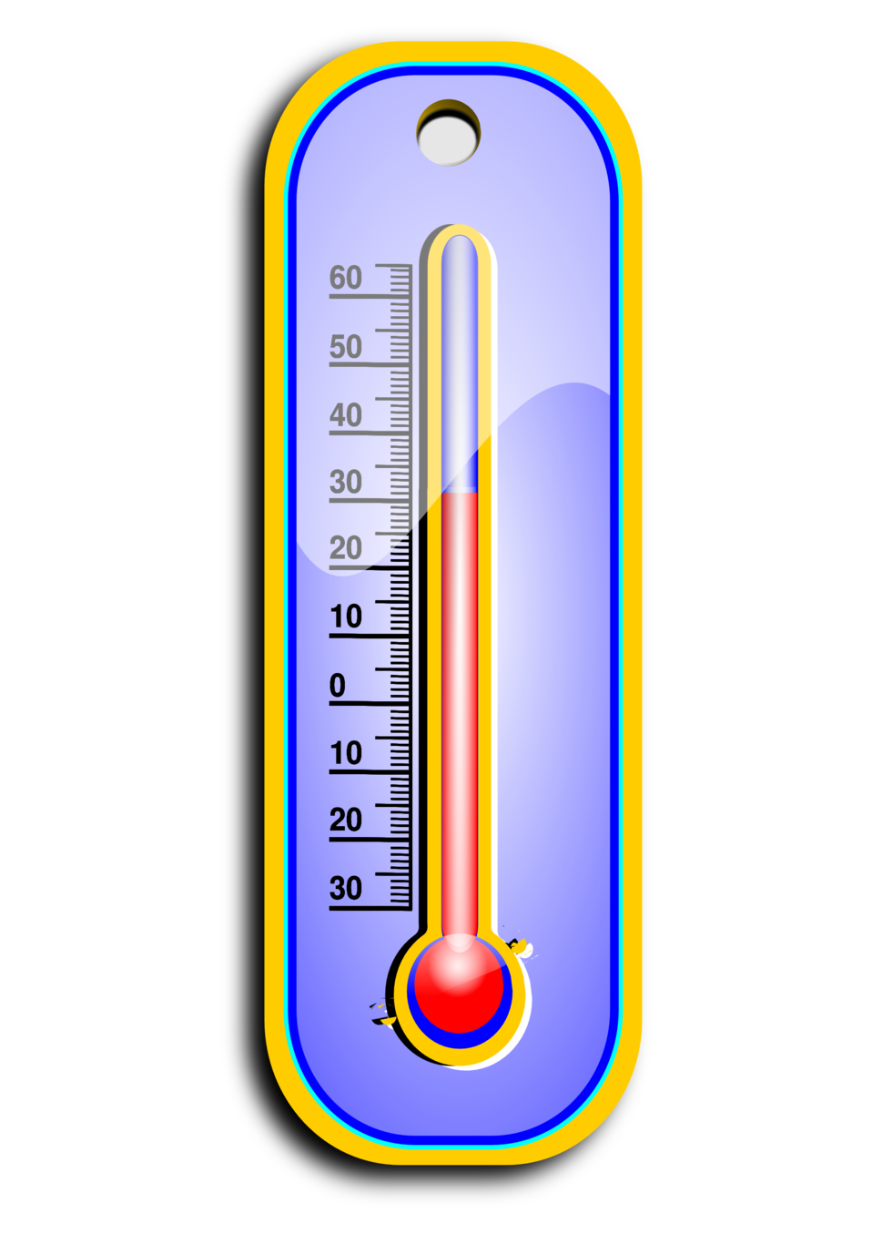

Sensors
light sensor
proximity sensor
accelerometer
gyroscope
magnetic compass
temperature
air pressure
Notes:
Sensors: light sensor, proximity sensor, accelerometer, gyroscope, magnetic compass, temperature, air pressure (altimeter)
Accessibility.

Slide 12
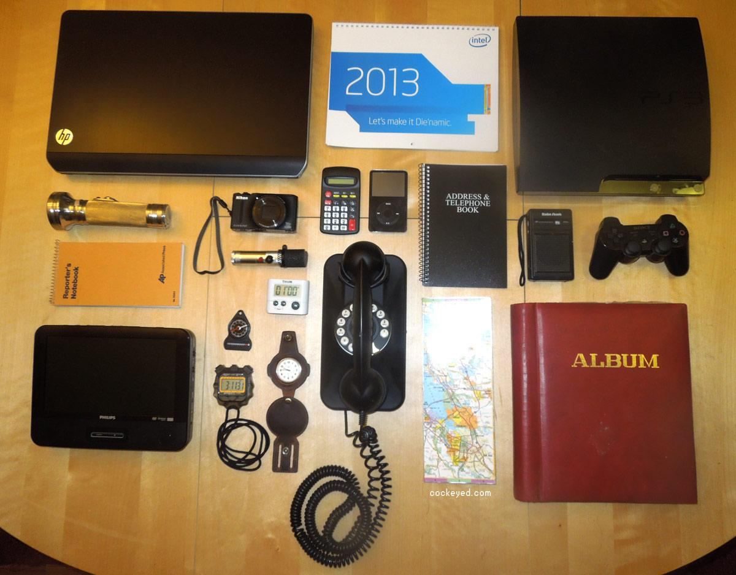
Notes:
Old-world equivalent kit

