Slide 1
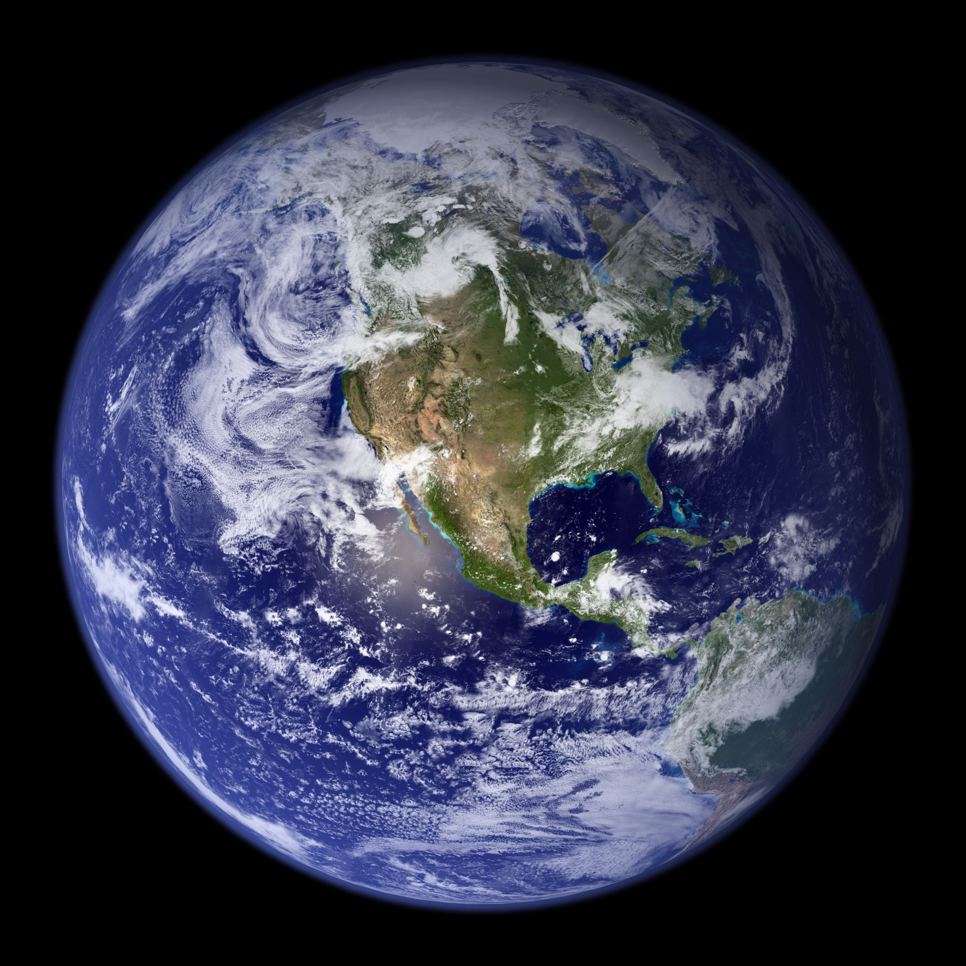
WATER

Slide 2
Where is Water in our Solar System?
Earth
The Moon
Mars
Europa (moon of Jupiter)
Enceladus (moon of Saturn)
Others? (other moons and Pluto)

Slide 3
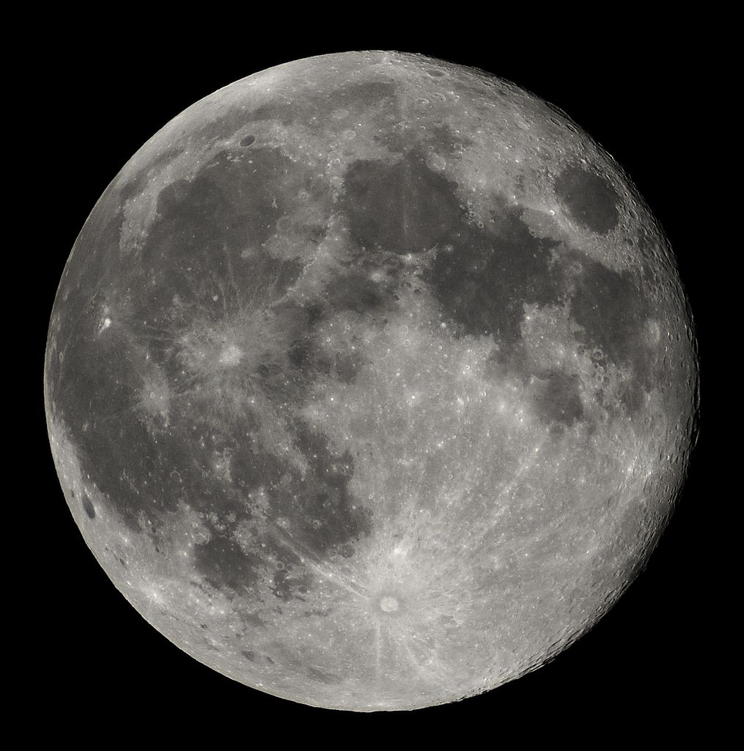
Moon

Slide 4
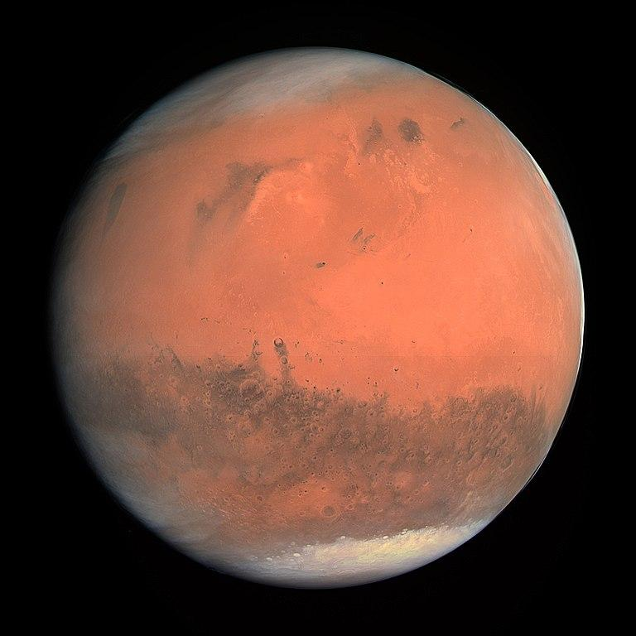
Mars

Slide 5
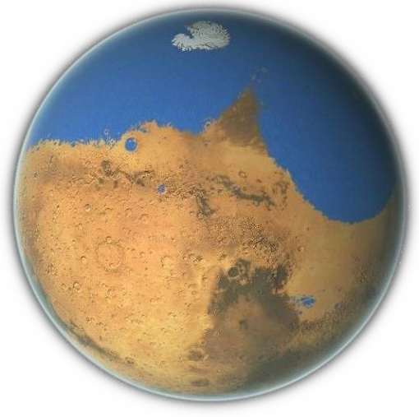
Mars
A long
time ago

Slide 6
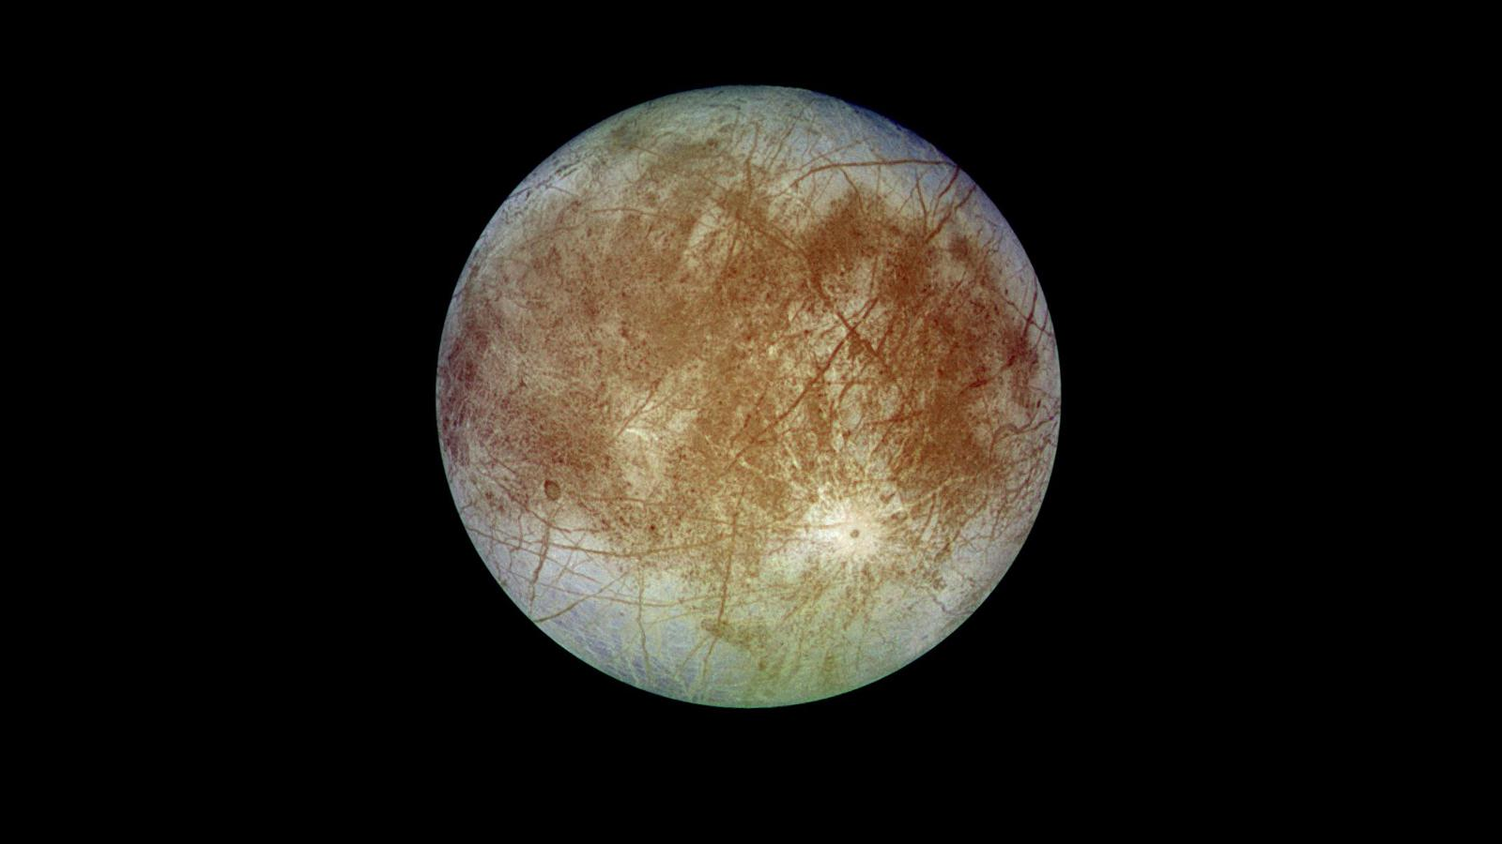
Europa

Slide 7
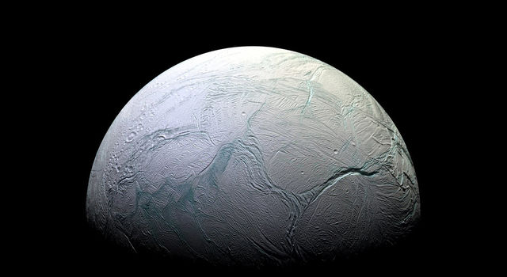
Enceladus

Slide 8
Things we use water for ...
Drinking
Growing food
Washing
Rocket fuel

Slide 9
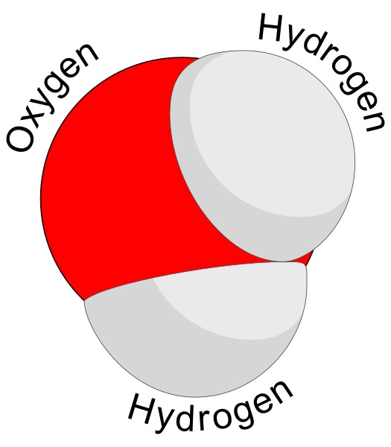
Water is a molecule
of Hydrogen and Oxygen
H₂O

Slide 10
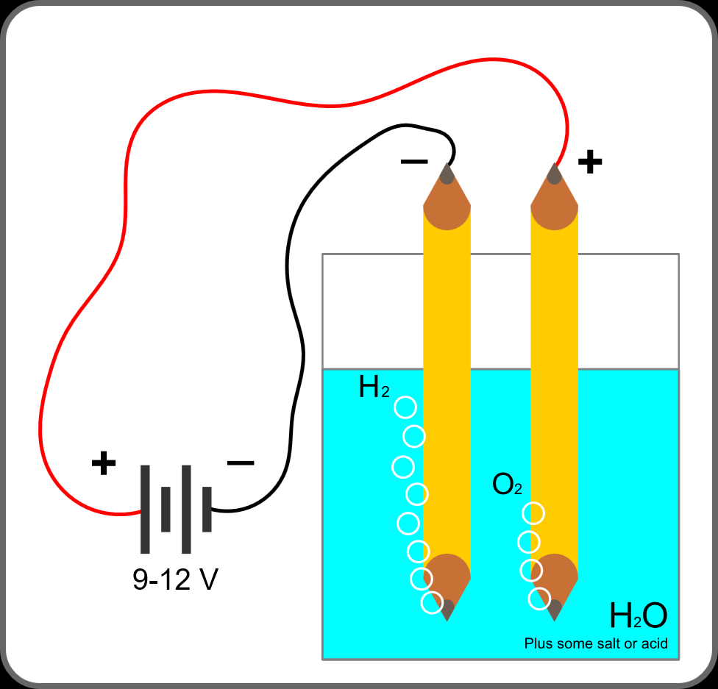
Electrolysis
of Water

Slide 11
